Slide 1



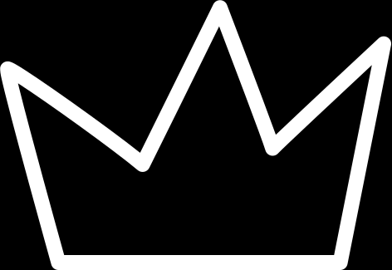
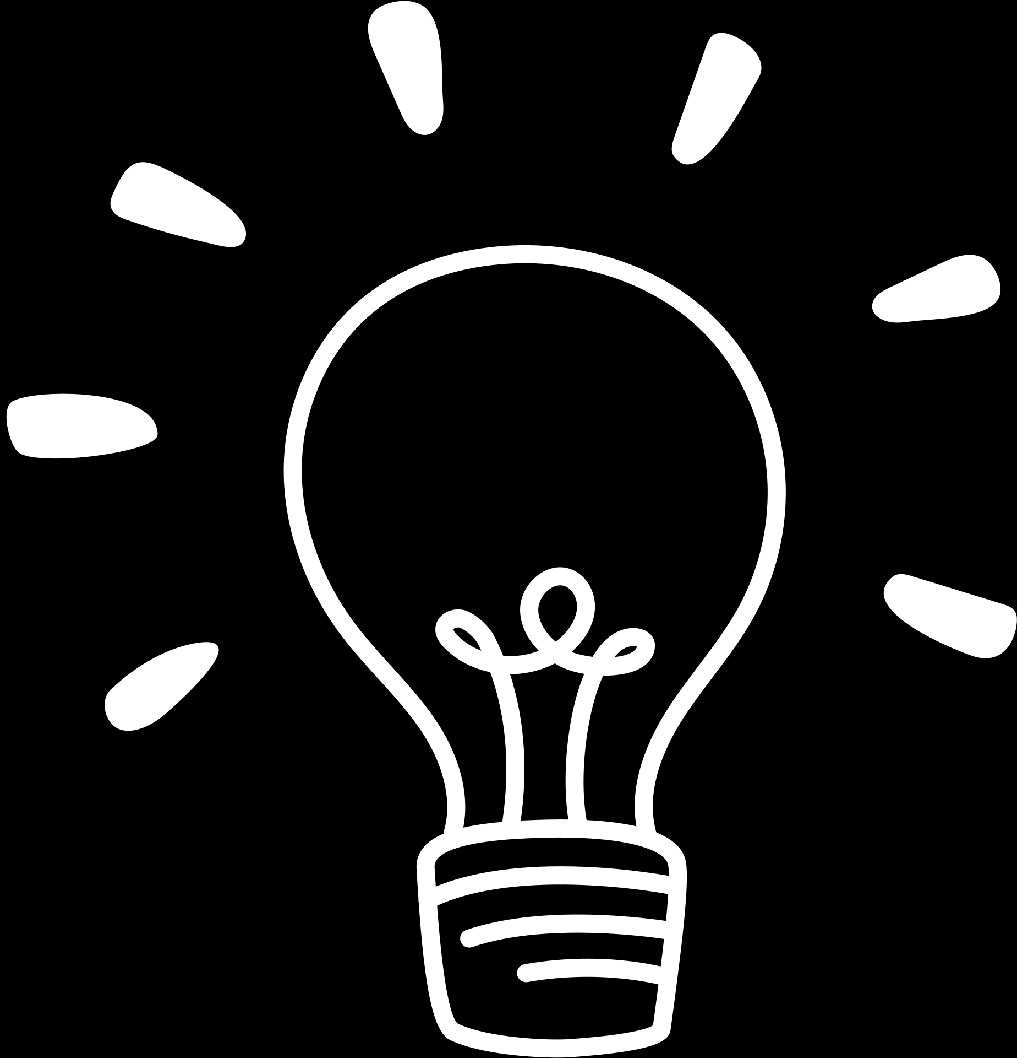

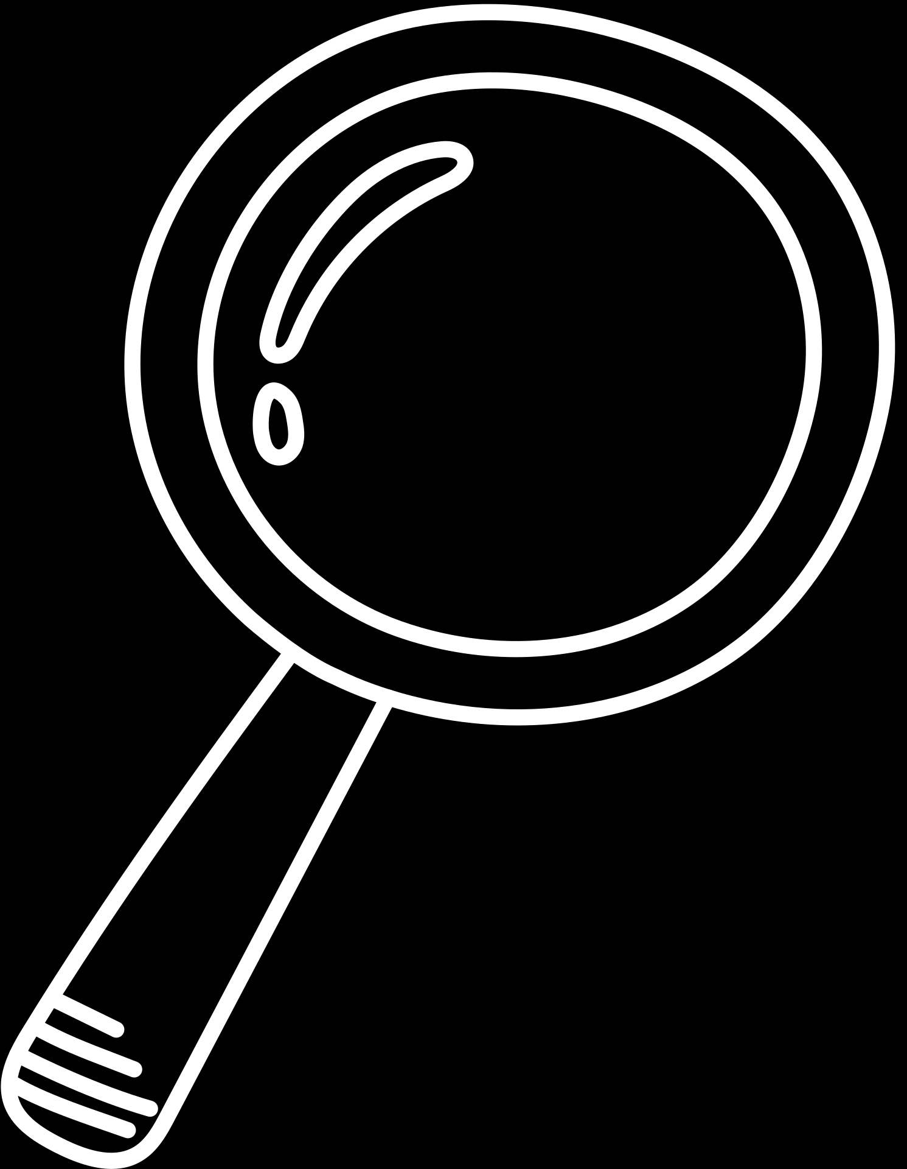


OOP
Project
AIRLINE MANAGEMENT SYSTEM

Slide 2


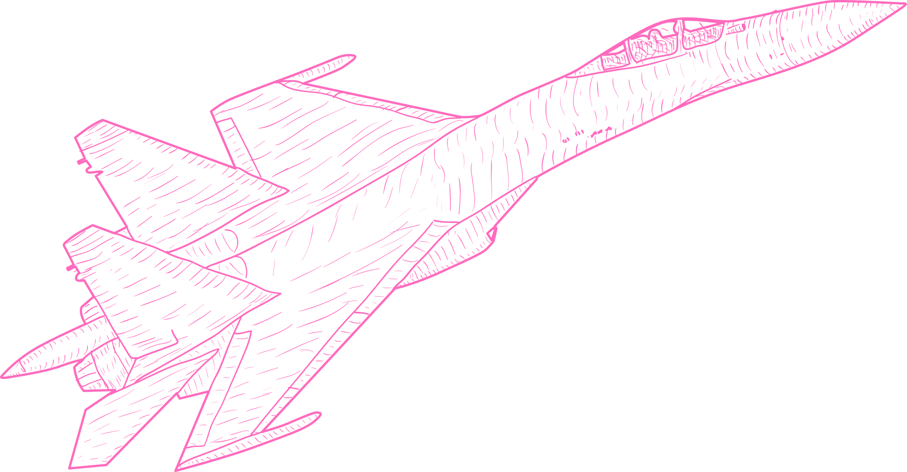
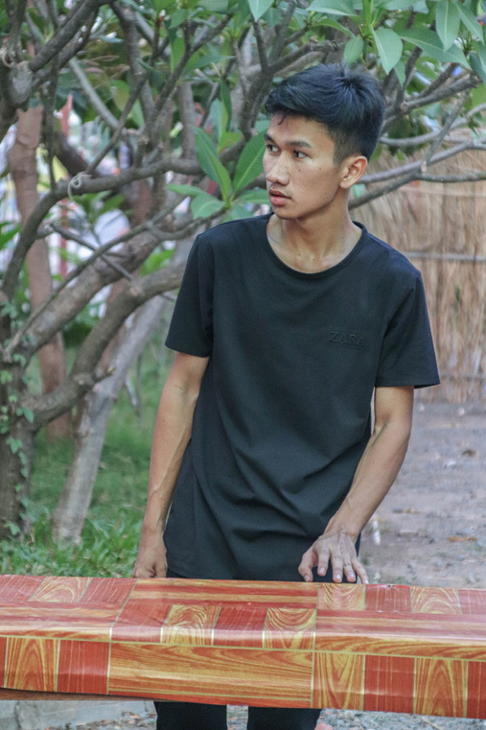



Group 23
Visal Sork
Vireak Reoun

Slide 3
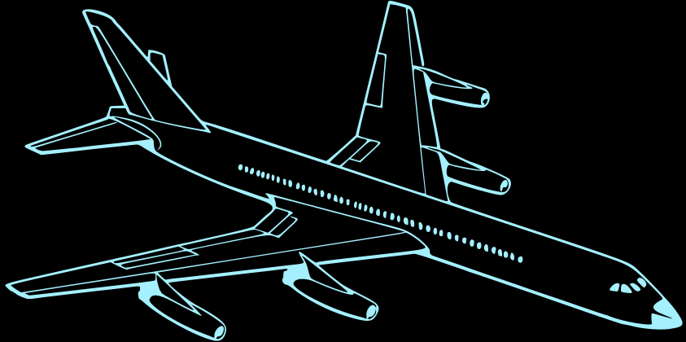


Table Content
1
2
3
What our system can do?
Some parts of our system
What we have learnt from this project

Slide 4



What our system can do
Visal Sork

Slide 5


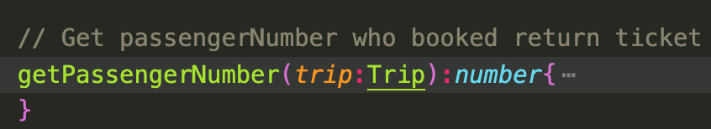
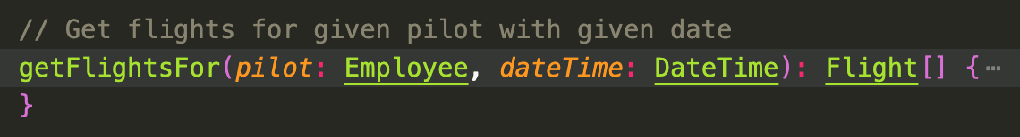
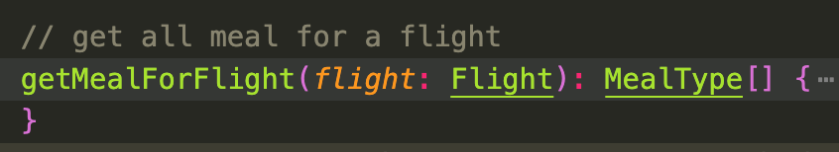
What our system can do
Get number of passengers booked return ticket
Get flights for a pilot
Get meals for a flight
Visal Sork

Slide 6
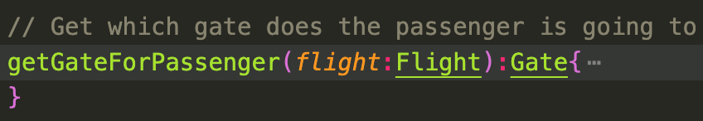
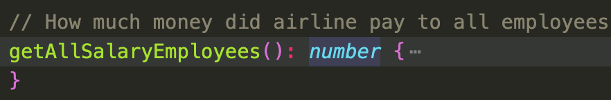
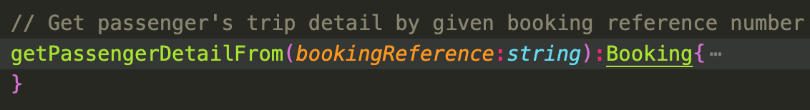
What our system can do
Get gate which plane
is waiting
Get money to pay employees
Get passenger's detail
Visal Sork

Slide 7
Some Parts Of Our System
Visal Sork

Slide 8
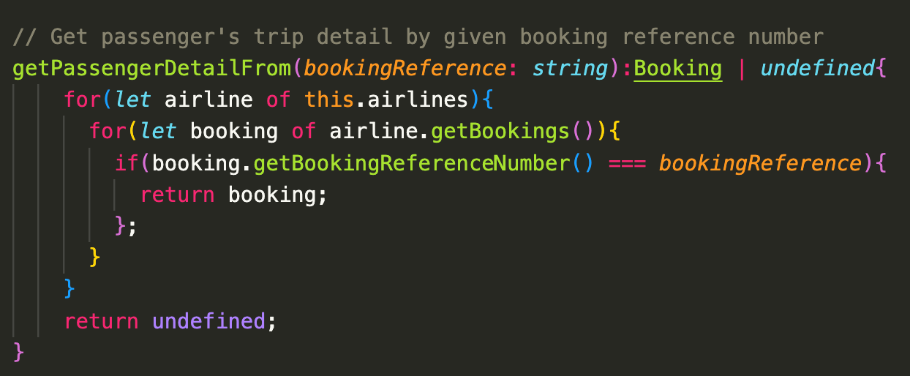
User Story 1: Get passenger's detail from booking reference number
Method
Visal Sork

Slide 9
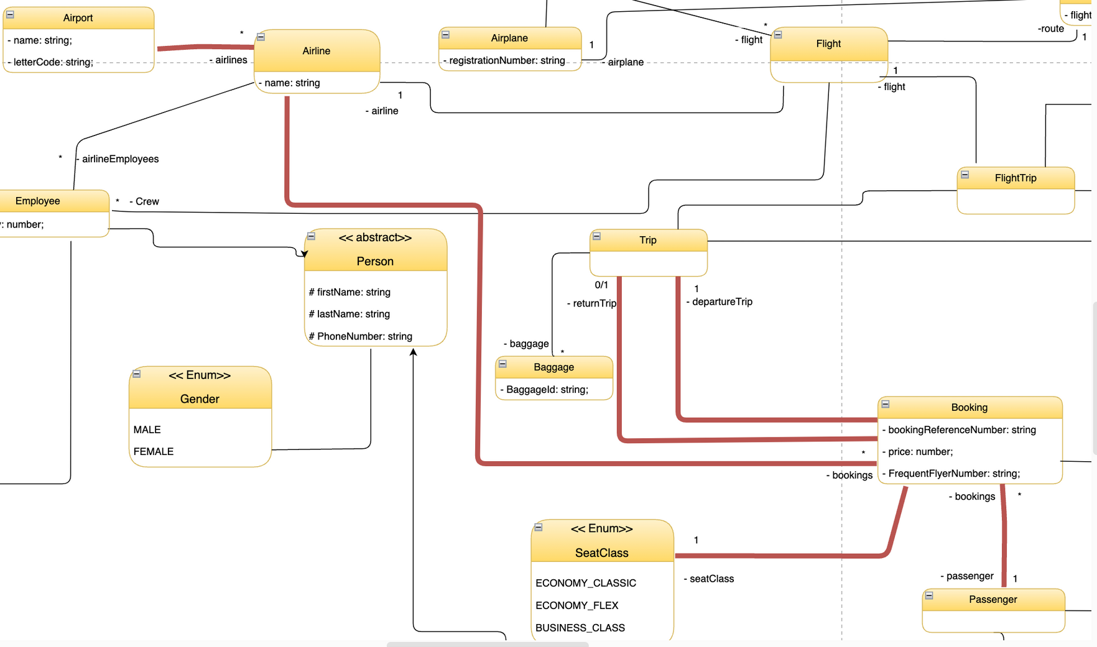
User Story 1: Get passenger's detail from booking reference number
UML
Visal Sork

Slide 10
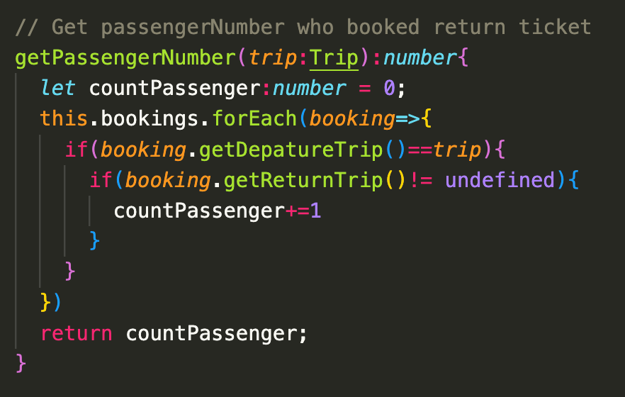
User Story 2: Get number of passengers were booking return tickets
Method
Visal Sork

Slide 11
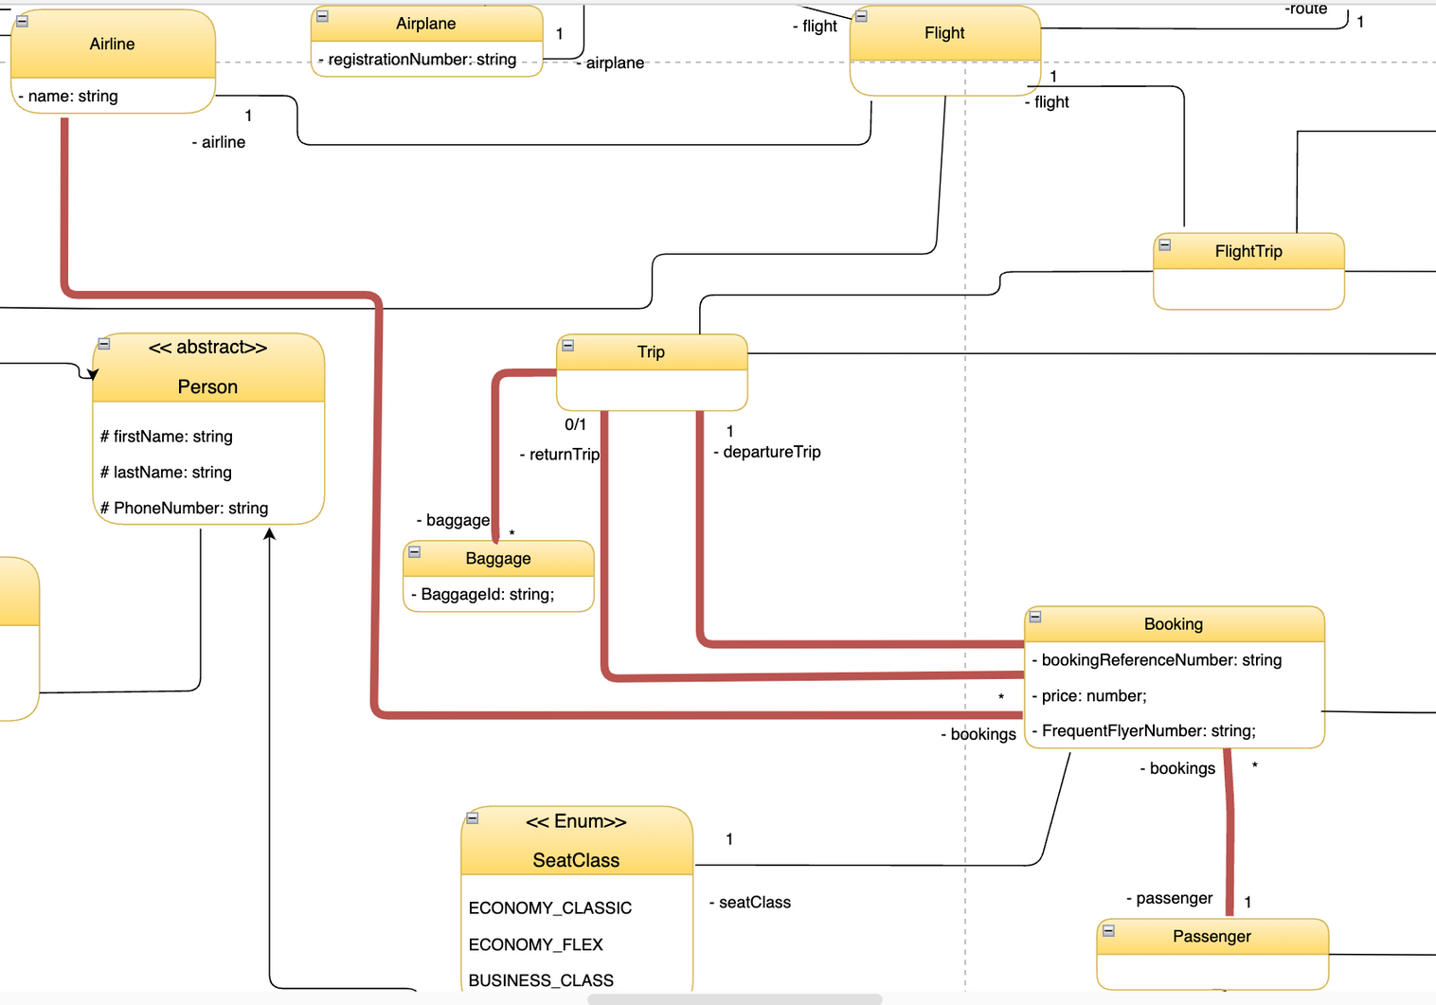
User Story 2: Get number of passengers were booking return tickets
UML
Visal Sork

Slide 12
Some Parts Of Our System
Vireak Roeun

Slide 13

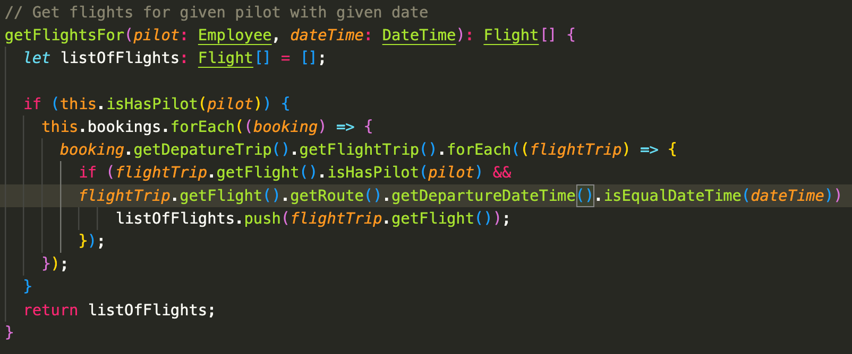
User Story 3: Get flights that pilot will join
Method
Vireak Roeun

Slide 14

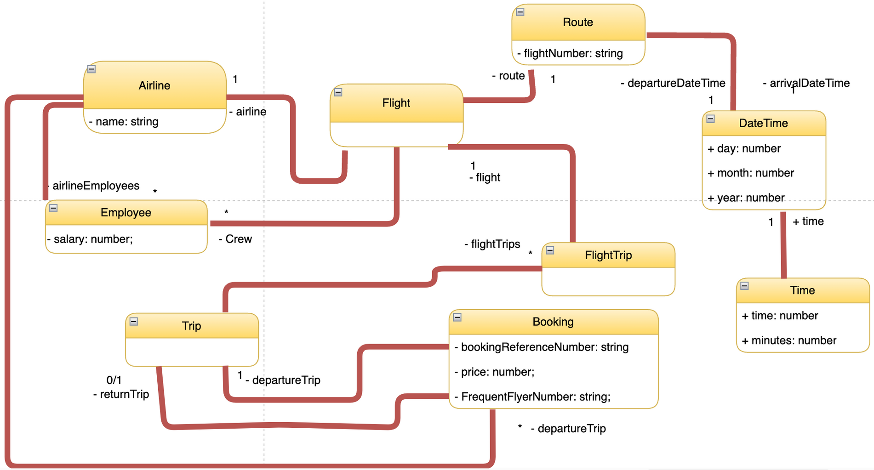


User Story 3: Get flights that pilot will join for a day
UML
Vireak Roeun

Slide 15
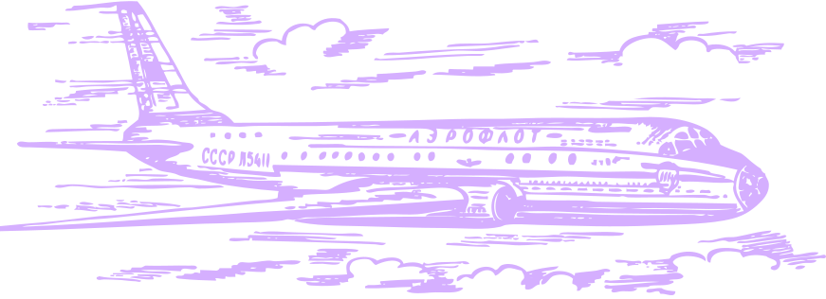
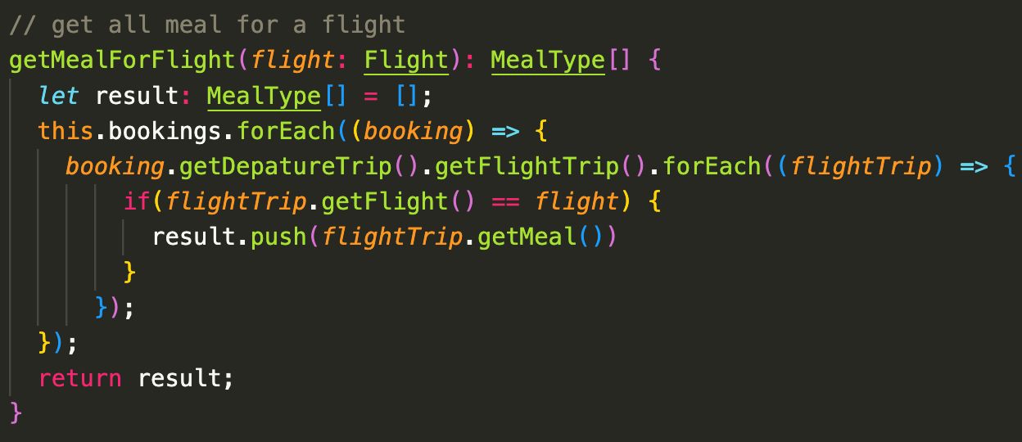
User Story 4: Get meals for a flight
Method
Vireak Roeun

Slide 16
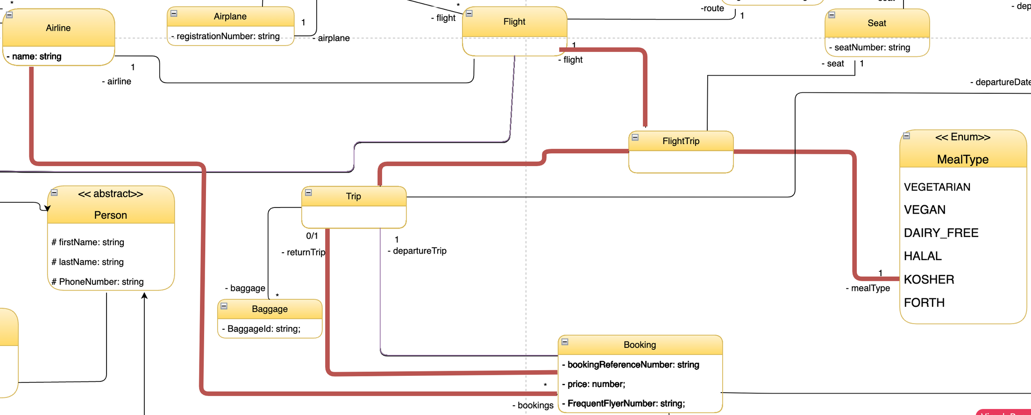
User Story 4: Get meals for a flight
UML
Vireak Roeun

Slide 17





What we have learnt
Hard Skills
Soft Skills
TypeScript
Avoid spaghetti code
UML Diagram
Communication
Trust
Problem Solving
Vireak Roeun

Slide 18


THANK YOU

